Slide 1
Simulations … so far
March 3rd, 2023

Slide 2
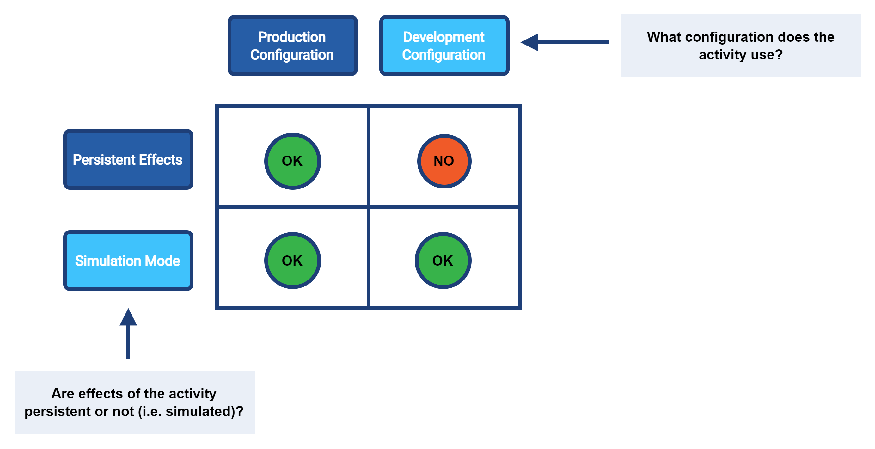
Activity Execution Aspects

Slide 3

Persistence
“Persistent-effects” mode
  any actions are really executed (repository, resources)
  they are also audited
“Simulation” mode
  no actions with externally-visible effects are executed *
  nothing is audited
“Shadow management simulation” mode
  only classification and correlation are carried out – and in simulation mode
“Report only” items
  everything is persistent, only selected items are simulated

Slide 4
Execution Modes
Execution Mode | Operational data (in shadows and other objects) | Shadow classification and correlation state | All data except for “report-only” items | “Report-only” items
Shadow management simulation | repository | simulation | ignored | ignored
(Full) simulation | repository | repository | simulation | simulation
Persistent effects | repository | repository | repository | simulation

Slide 5
Configuration Sets
Production configuration
  items engaged in regular midPoint operations
Development configuration
  parts of configuration that are being developed
(currently) distinguished by lifecycle state

Slide 6
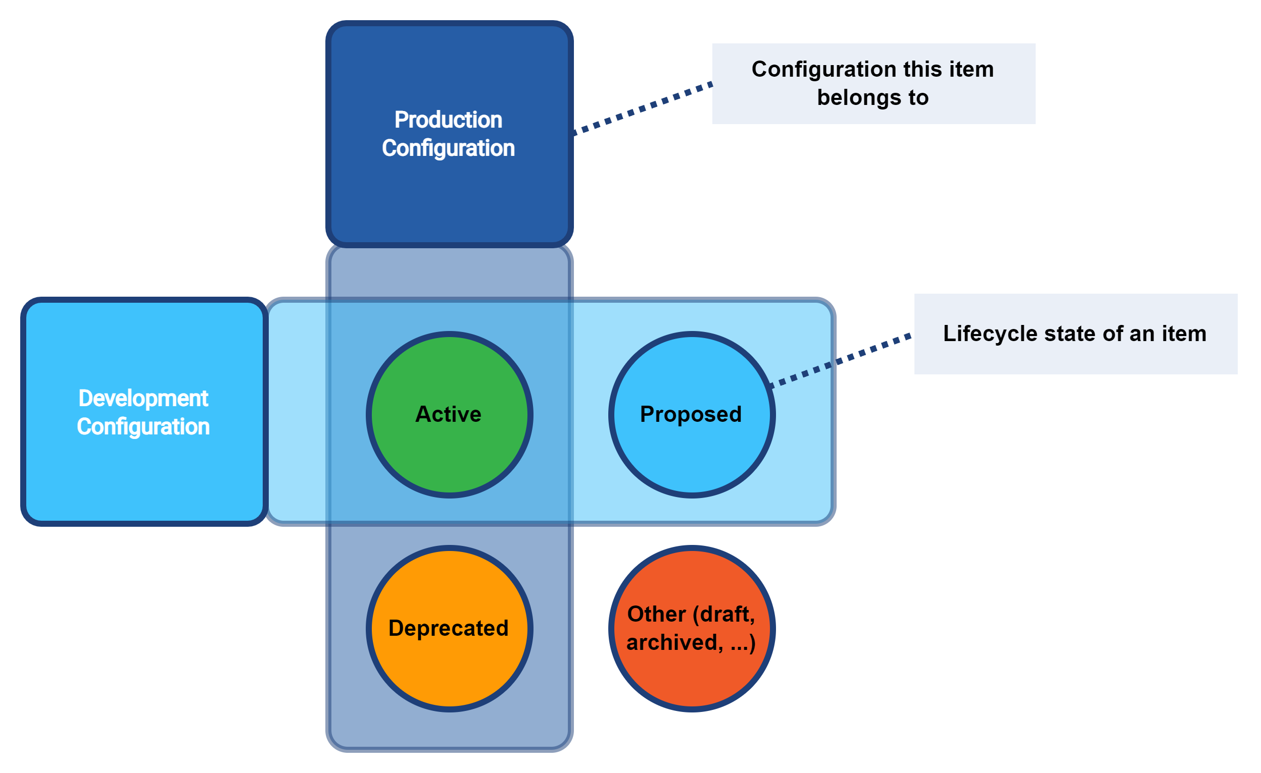
Configuration Sets

Slide 7
Lifecycle State
resource
resource object class
resource object type
attribute
association
role, org, service, archetype
assignment
object template
mapping

Slide 8
Demo

Slide 9
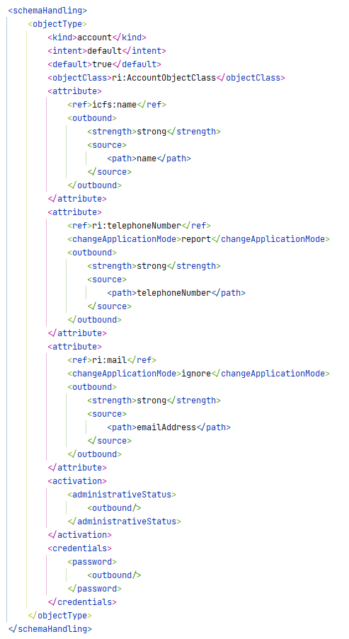
Report-Only Items
(or “simulation-only”?)
report = deltas go to simulation result
  in simulation mode it is automatic
  in “persistent effects” mode if the result is present
ignore =
  mappings nor deltas are not computed
Beware of chaining!
Limited reporting.

